Slide 1
Soymap classification and timing algorithm check
April 1, 2019

Slide 2
Summary (toSally)

Slide 3
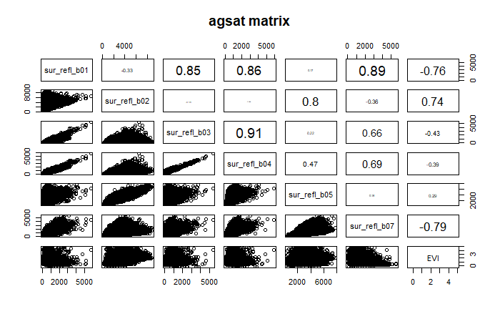
Based on spectral and phenological differences, target mid to late vegetative stage of first crop and the whole second crop; avoid dry season
Use only ‘useful’ bands and times of year as input data
Use two sets of input data:
Band1 and band2 from December to June
EVI from December to June

Slide 4
Soymaps
Evaluate not only for Planet images (which are heavy on DC and therefore give overly optimistic estimate of accuracy), but also produce confusion matrix from the actual sample points
 | Class | Jake’s | Soymap 1 | Soymap 2 | Soymap 3 | Soymap 4 | Soymap 5 | Soymap 6
Training points |  | Agsat | Agsat | Agsat + PLOS | Agsat + PLOS | Agsat + PLOS | Agsat + reclassed PLOS | Agsat
Input data |  | Aqua + landsat | Aqua + landsat | Aqua | Aqua B1 + B2, Dec to June | Aqua EVI, Dec to June | Aqua EVI, Dec to June | Aqua EVI, Dec to June
Accuracy |  | 76 | 76.9 | 73.5 | 75.2 | 76.7 | 78.5 | 79.7
Consumer’s accuracy | 0 | 0.39 | 0.51 | 0.45 | 0.44 | 0.52 | 0.54 | 0.51
 | 1 | 0.85 | 0.85 | 0.8 | 0.8 | 0.8 | 0.82 | 0.84
 | 2 | 0.47 | 0.4 | 0.35 | 0.44 | 0.53 | 0.46 | 0.47
Producer’s accuracy | 0 | 0.39 | 0.47 | 0.35 | 0.25 | 0.24 | 0.29 | 0.33
 | 1 | 0.85 | 0.86 | 0.86 | 0.9 | 0.92 | 0.92 | 0.92
 | 2 | 0.44 | 0.47 | 0.3 | 0.37 | 0.4 | 0.35 | 0.31

Slide 5

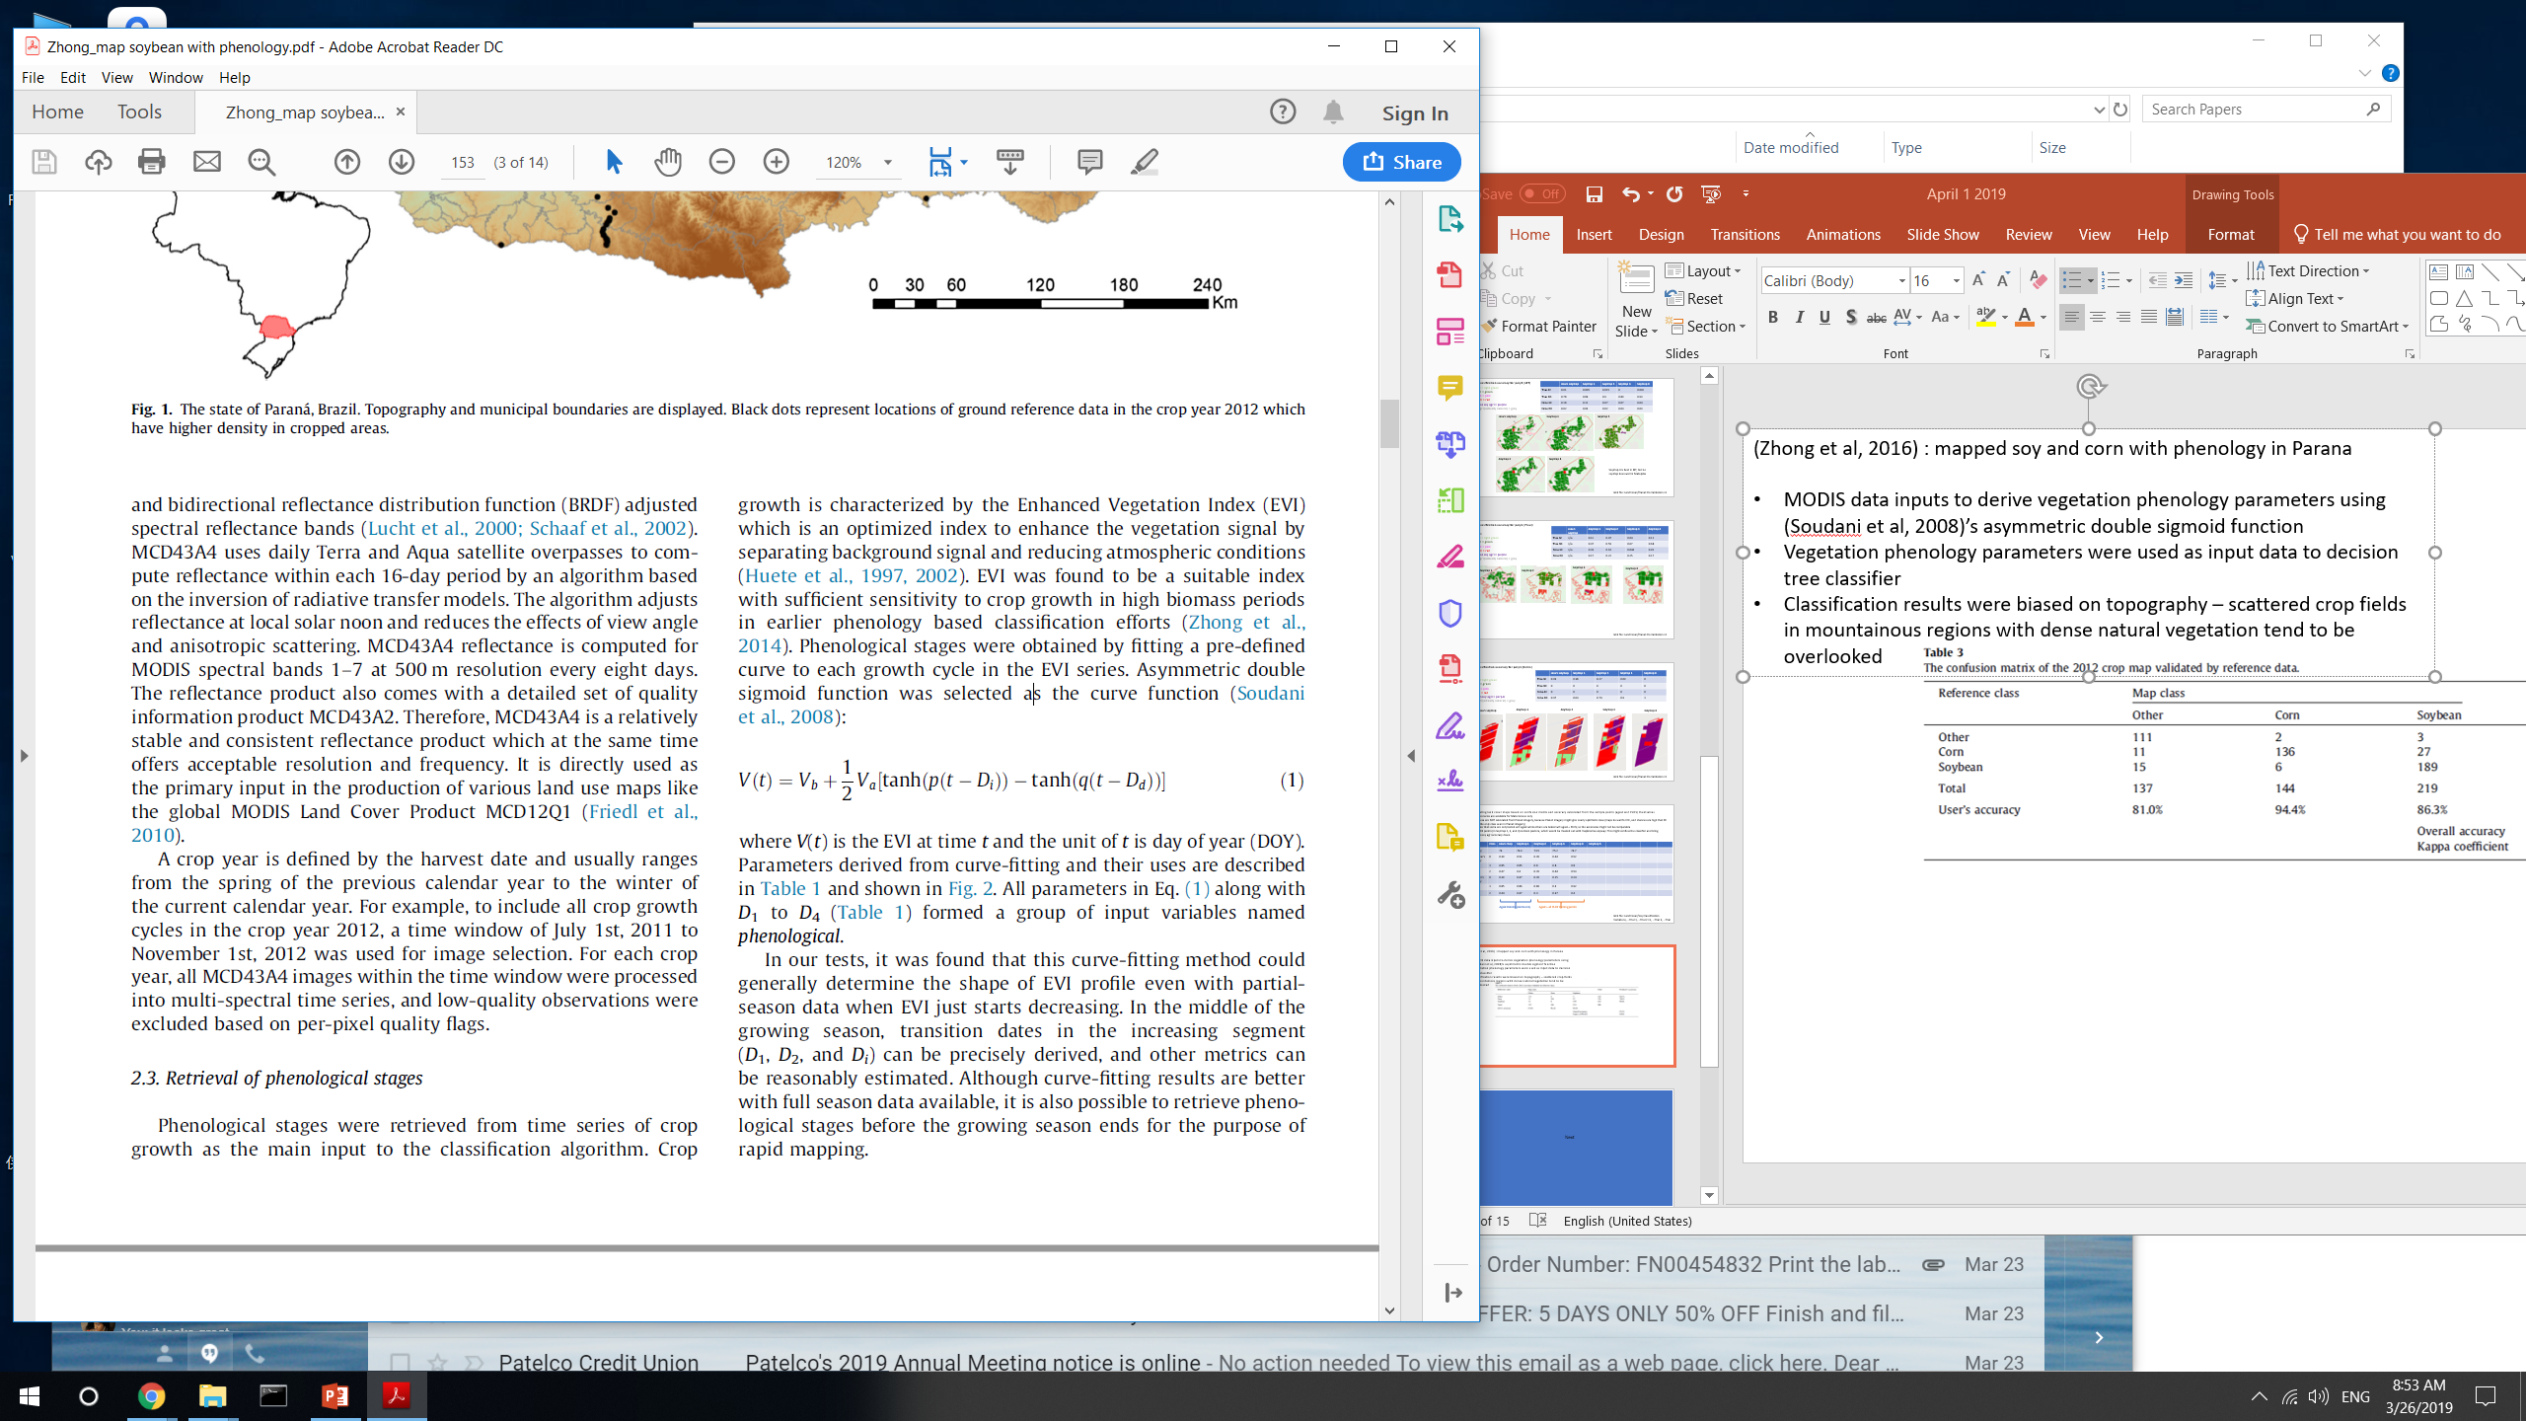
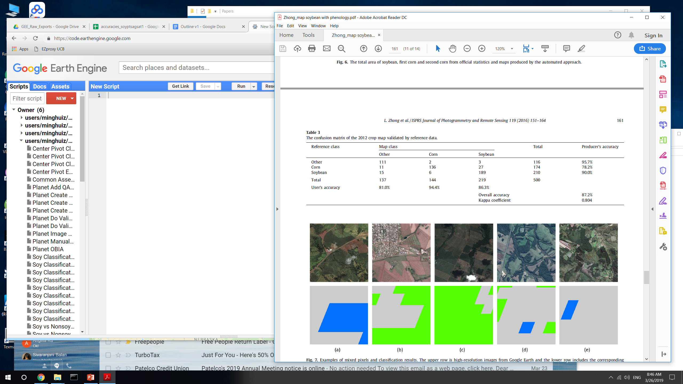
(Zhong et al, 2016) : mapped soy and corn with phenology in Parana
MODIS data inputs to derive vegetation phenology parameters using (Soudani et al, 2008)’s asymmetric double sigmoid function
Vegetation phenology parameters were used as input data to decision tree classifier
TAKEAWAY: improvement using different inputs based on MODIS bands is only incremental, can’t get up to ~87% accuracy. Need phenological information.

Slide 6
 | Class | Soymap 7 | Soymap 8 | Soymap 9 | Soymap 10
Training points |  | Agsat | Agsat | agsat | Agsat
Input data |  | Phenology | Phenology + aqua + terra B1 and B2 | Phenology + aqua + terra B1 and B2, smoothed | Phenology + aqua + terra EVI, smoothed
Accuracy |  | 81.8 | 81.1 | 78.8 | 82.5
Consumer’s accuracy | 0 | 0.58 | 0.58 | 0.47 | 0.59
 | 1 | 0.86 | 0.85 | 0.84 | 0.86
 | 2 | 0.57 | 0.58 | 0.49 | 0.65
Producer’s accuracy | 0 | 0.44 | 0.35 | 0.33 | 0.44
 | 1 | 0.92 | 0.93 | 0.91 | 0.92
 | 2 | 0.4 | 0.47 | 0.36 | 0.44
Next?
Starting from Soymap 6 (which doesn’t rely on timing map), add in cloud masking; smoothing; and terra in addition to aqua
Starting from Soymap 10, fine-tune the input data more; or take out phenological data and just use spectral data (at specific phenological stages)

Slide 7
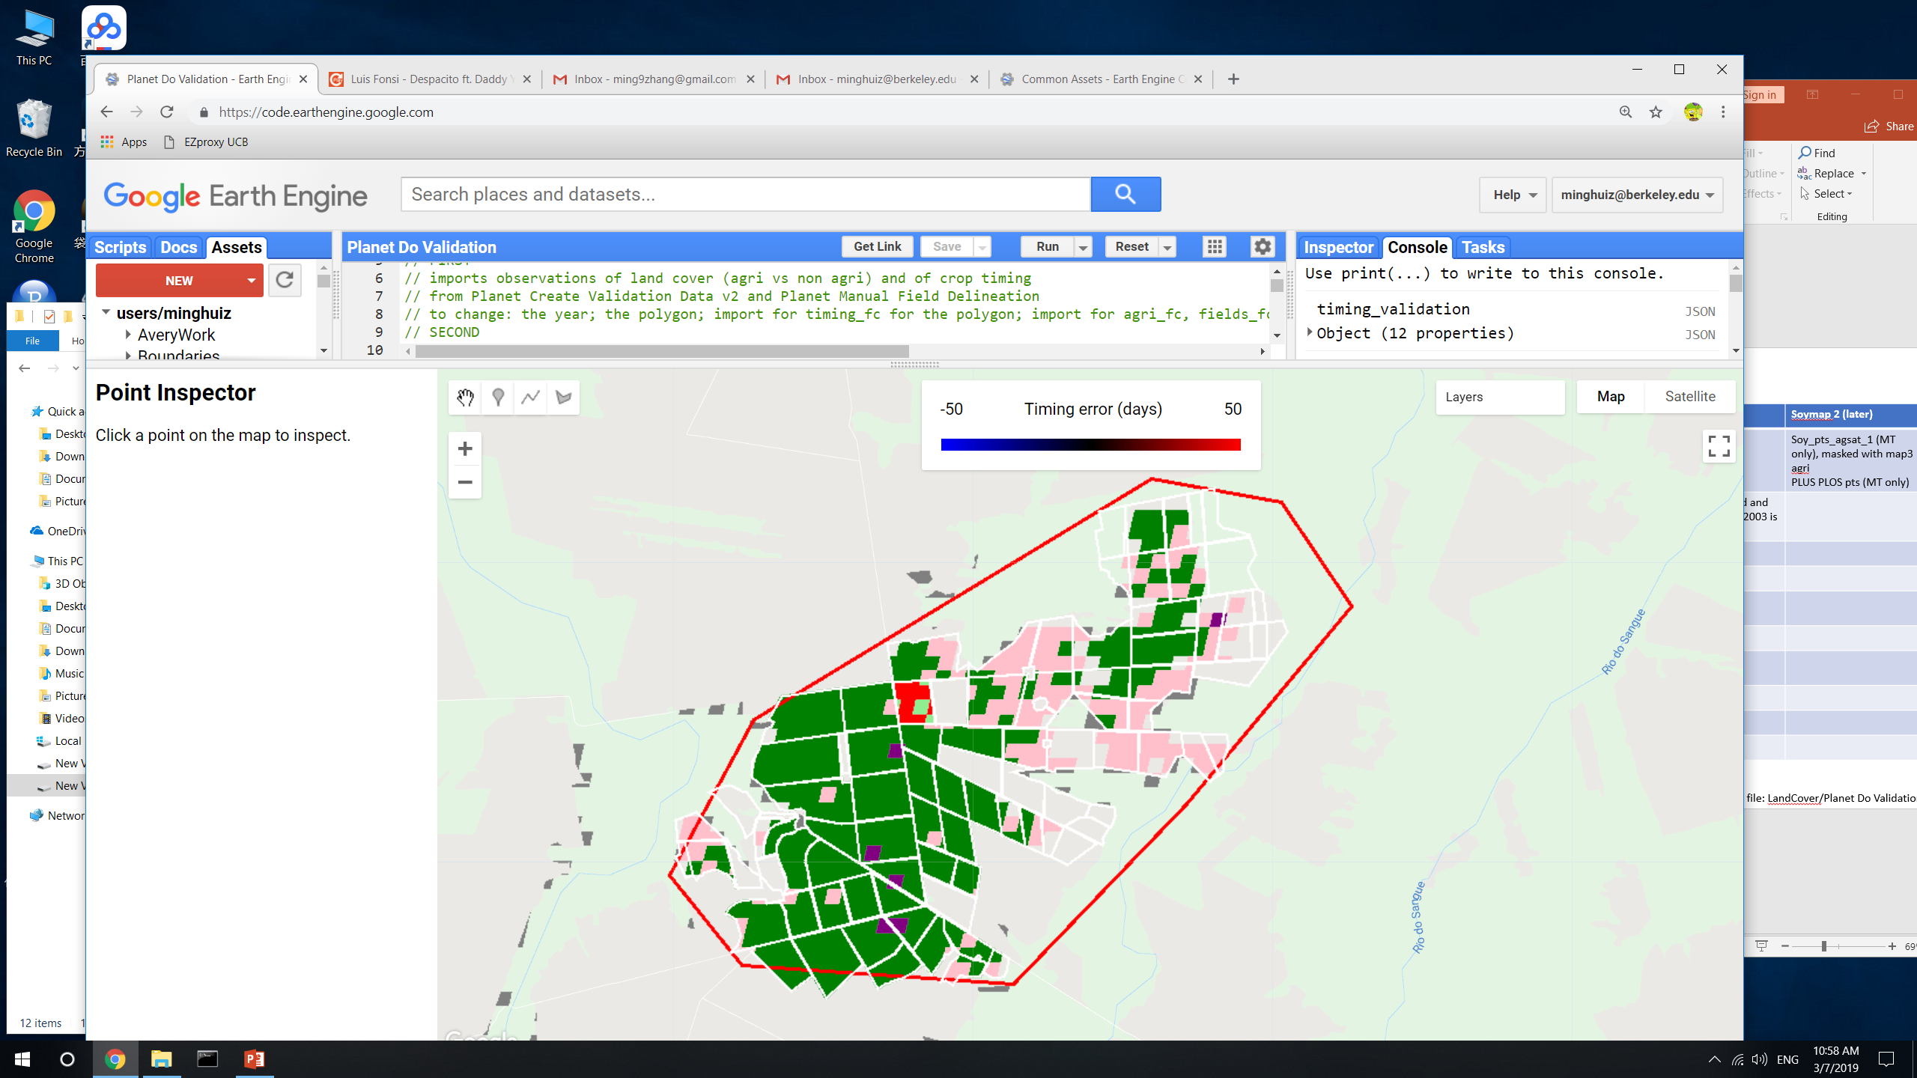
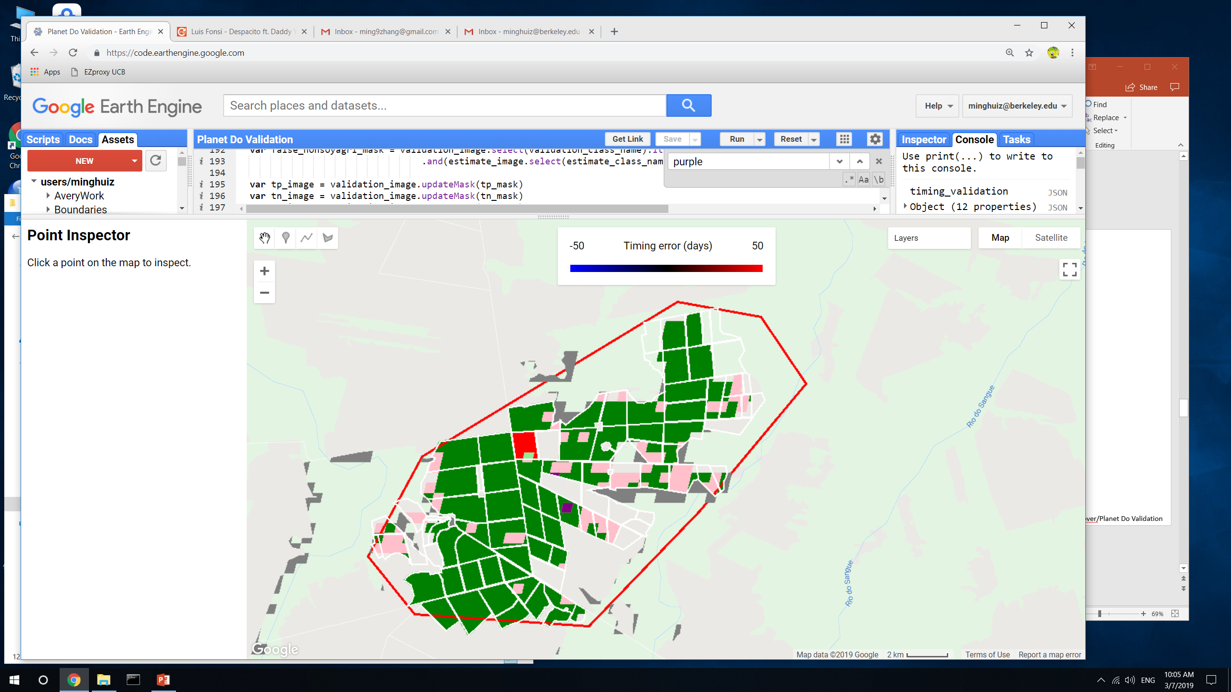
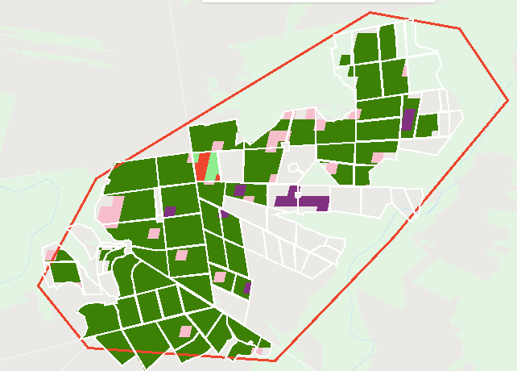
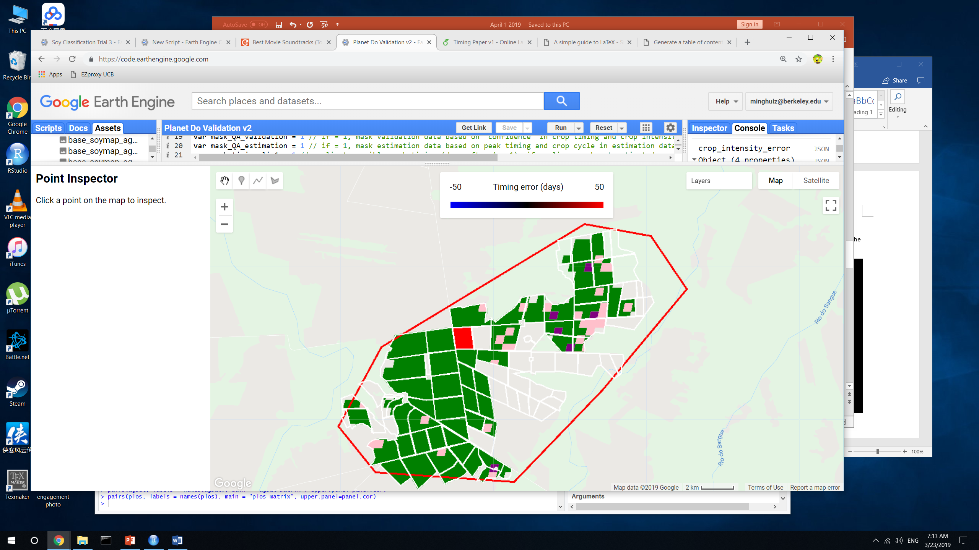
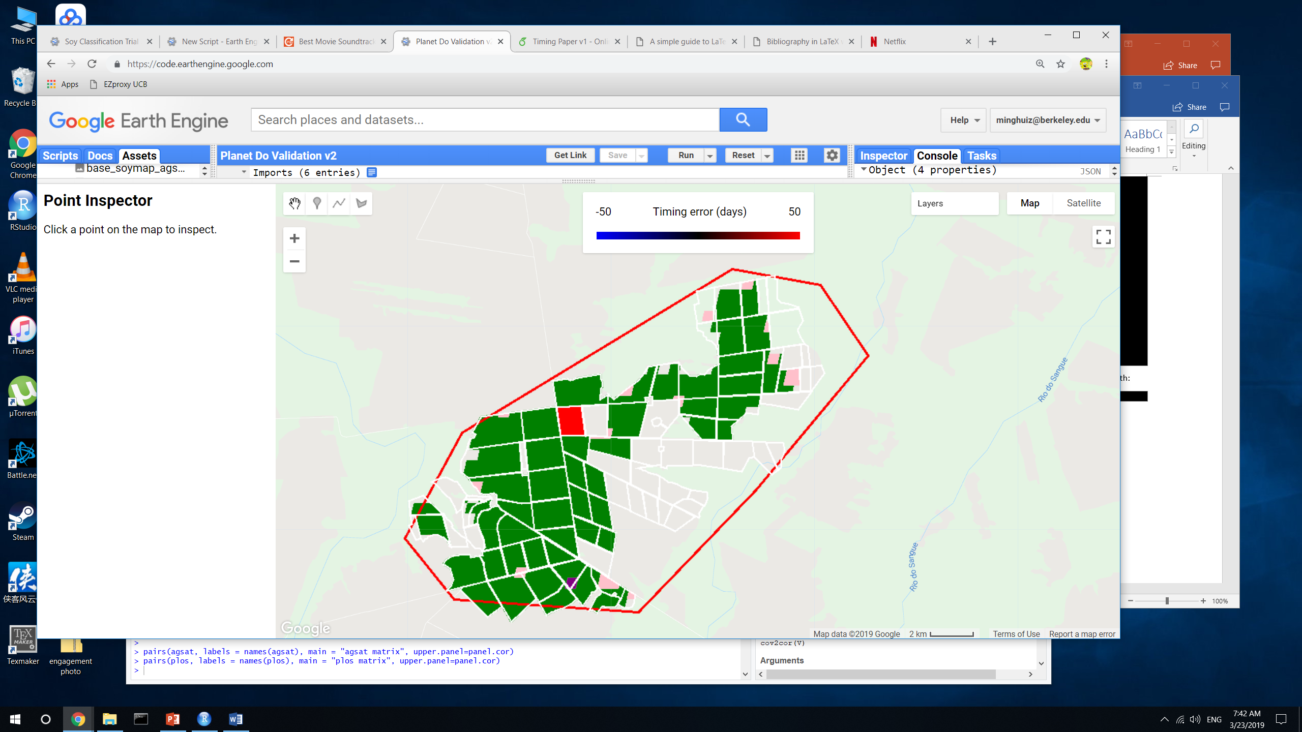
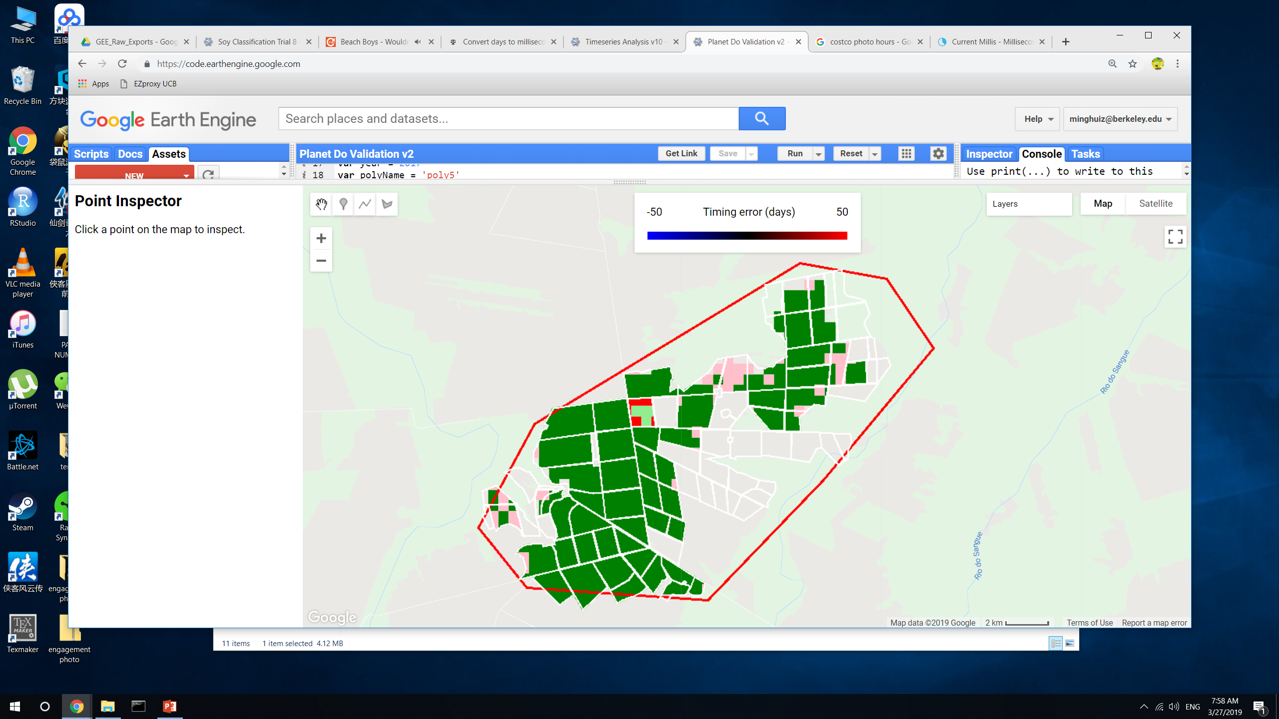
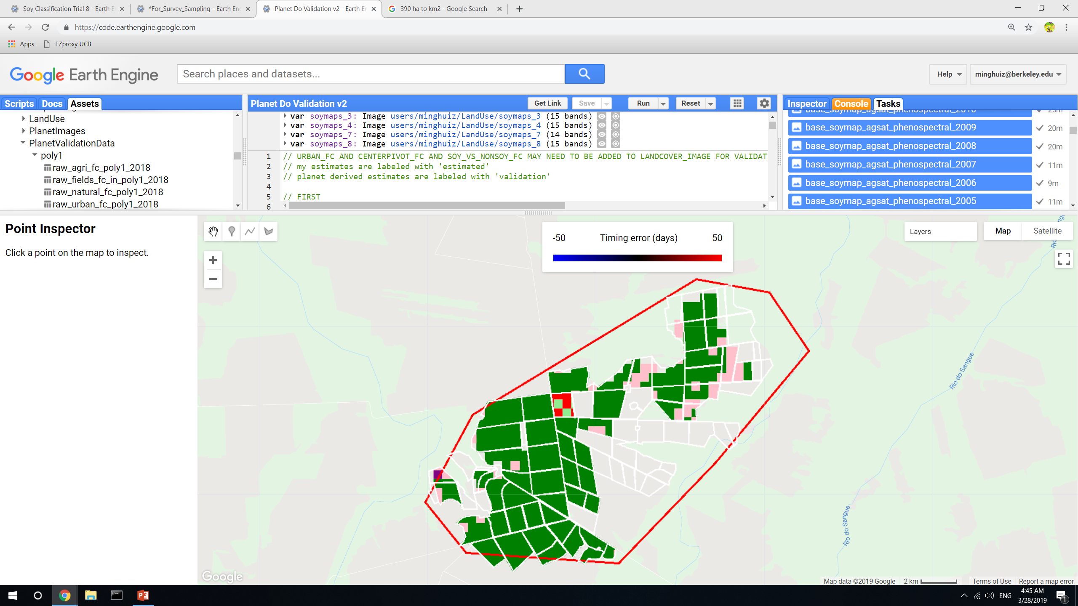
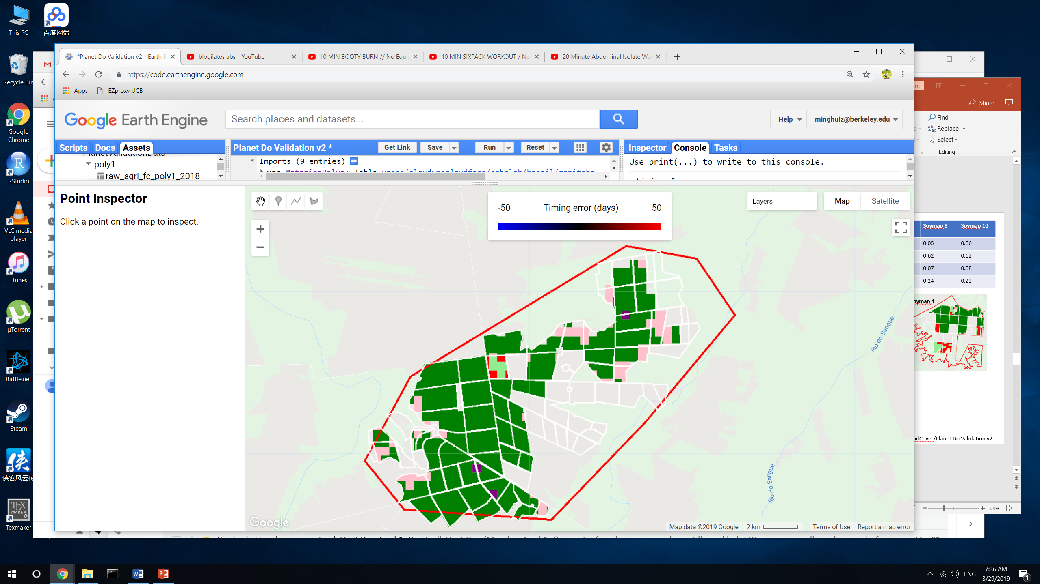
Land classification accuracy for poly5 (MT)
True SC = light green
True DC = green
False SC = pink
False DC = red
False nonsoy agri = purple
False agri (actually natural) = gray
 | Jake’s soymap | Soymap 1 | Soymap 2 | Soymap 3 | Soymap 4 | Soymap 7 | Soymap 8 | Soymap 10
True SC | 0.01 | 0.005 | 0.015 | 0 | 0.002 | 0.01 | 0.01 | 0.01
True DC | 0.78 | 0.86 | 0.9 | 0.89 | 0.93 | 0.87 | 0.87 | 0.84
False SC | 0.18 | 0.11 | 0.07 | 0.07 | 0.04 | 0.1 | 0.1 | 0.12
False DC | 0.02 | 0.03 | 0.02 | 0.03 | 0.03 | 0.02 | 0.02 | 0.02
Jake’s soymap
Soymap 1
Soymap 2
Soymap 3
Soymap 4
Soymap 7
Soymap 8
Soymap 10
GEE file: LandCover/Planet Do Validation v2

Slide 8
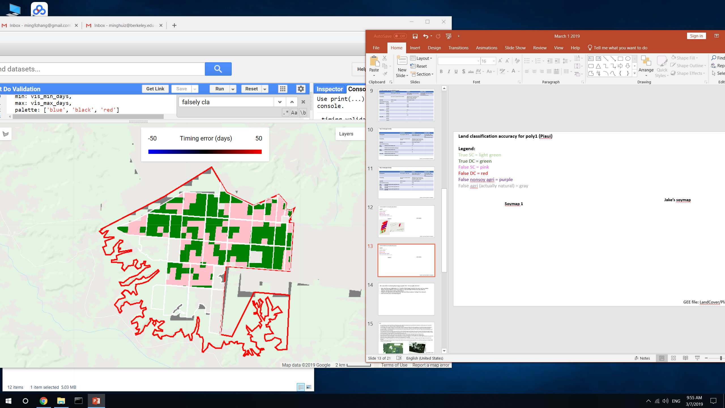
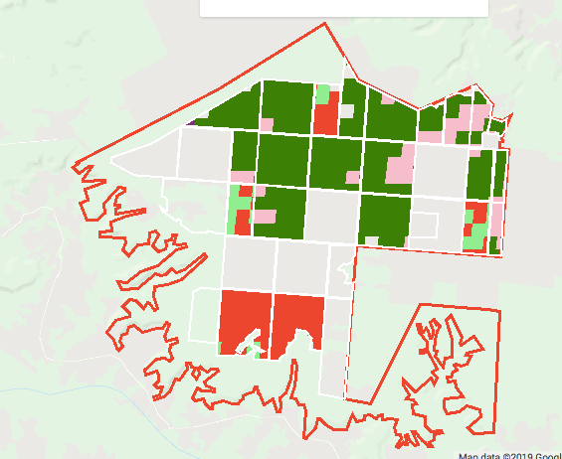
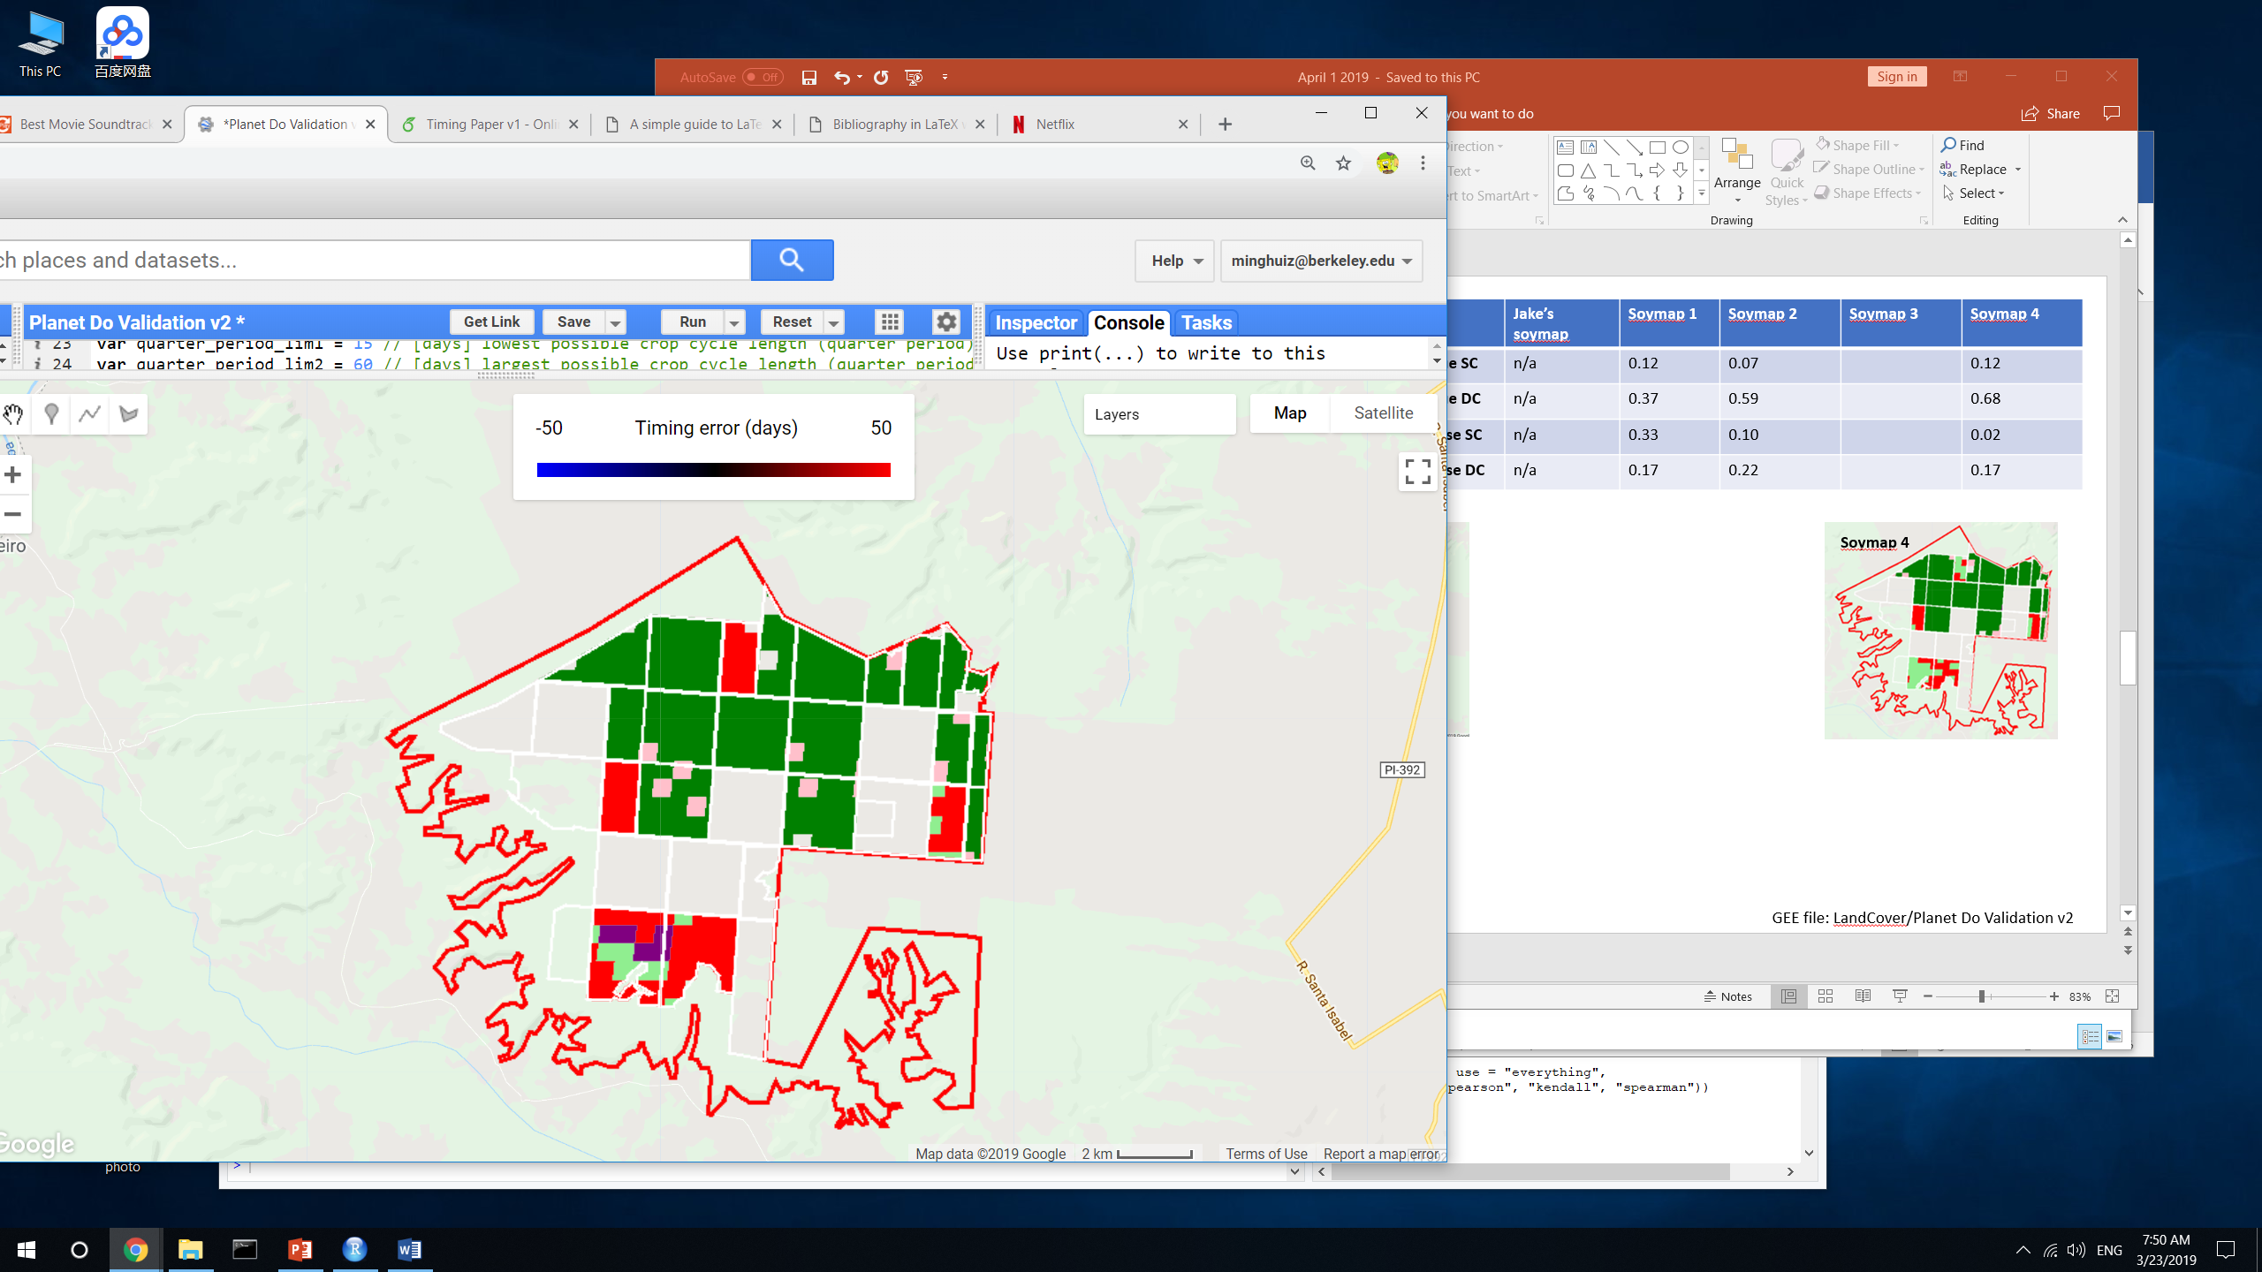
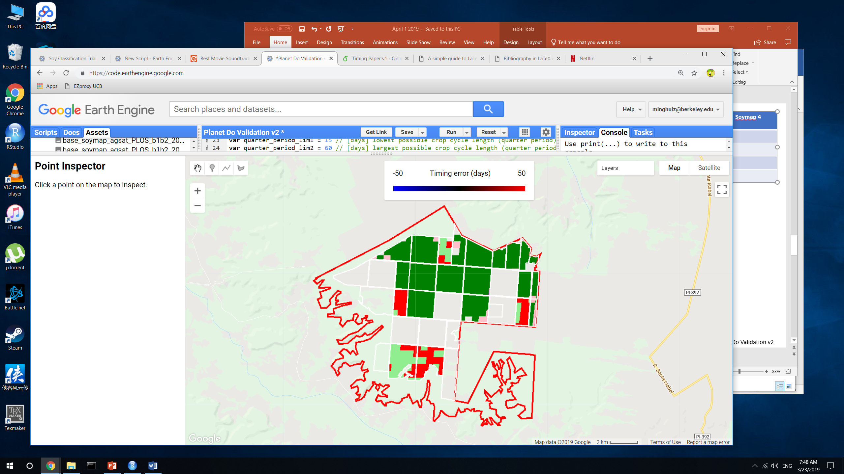
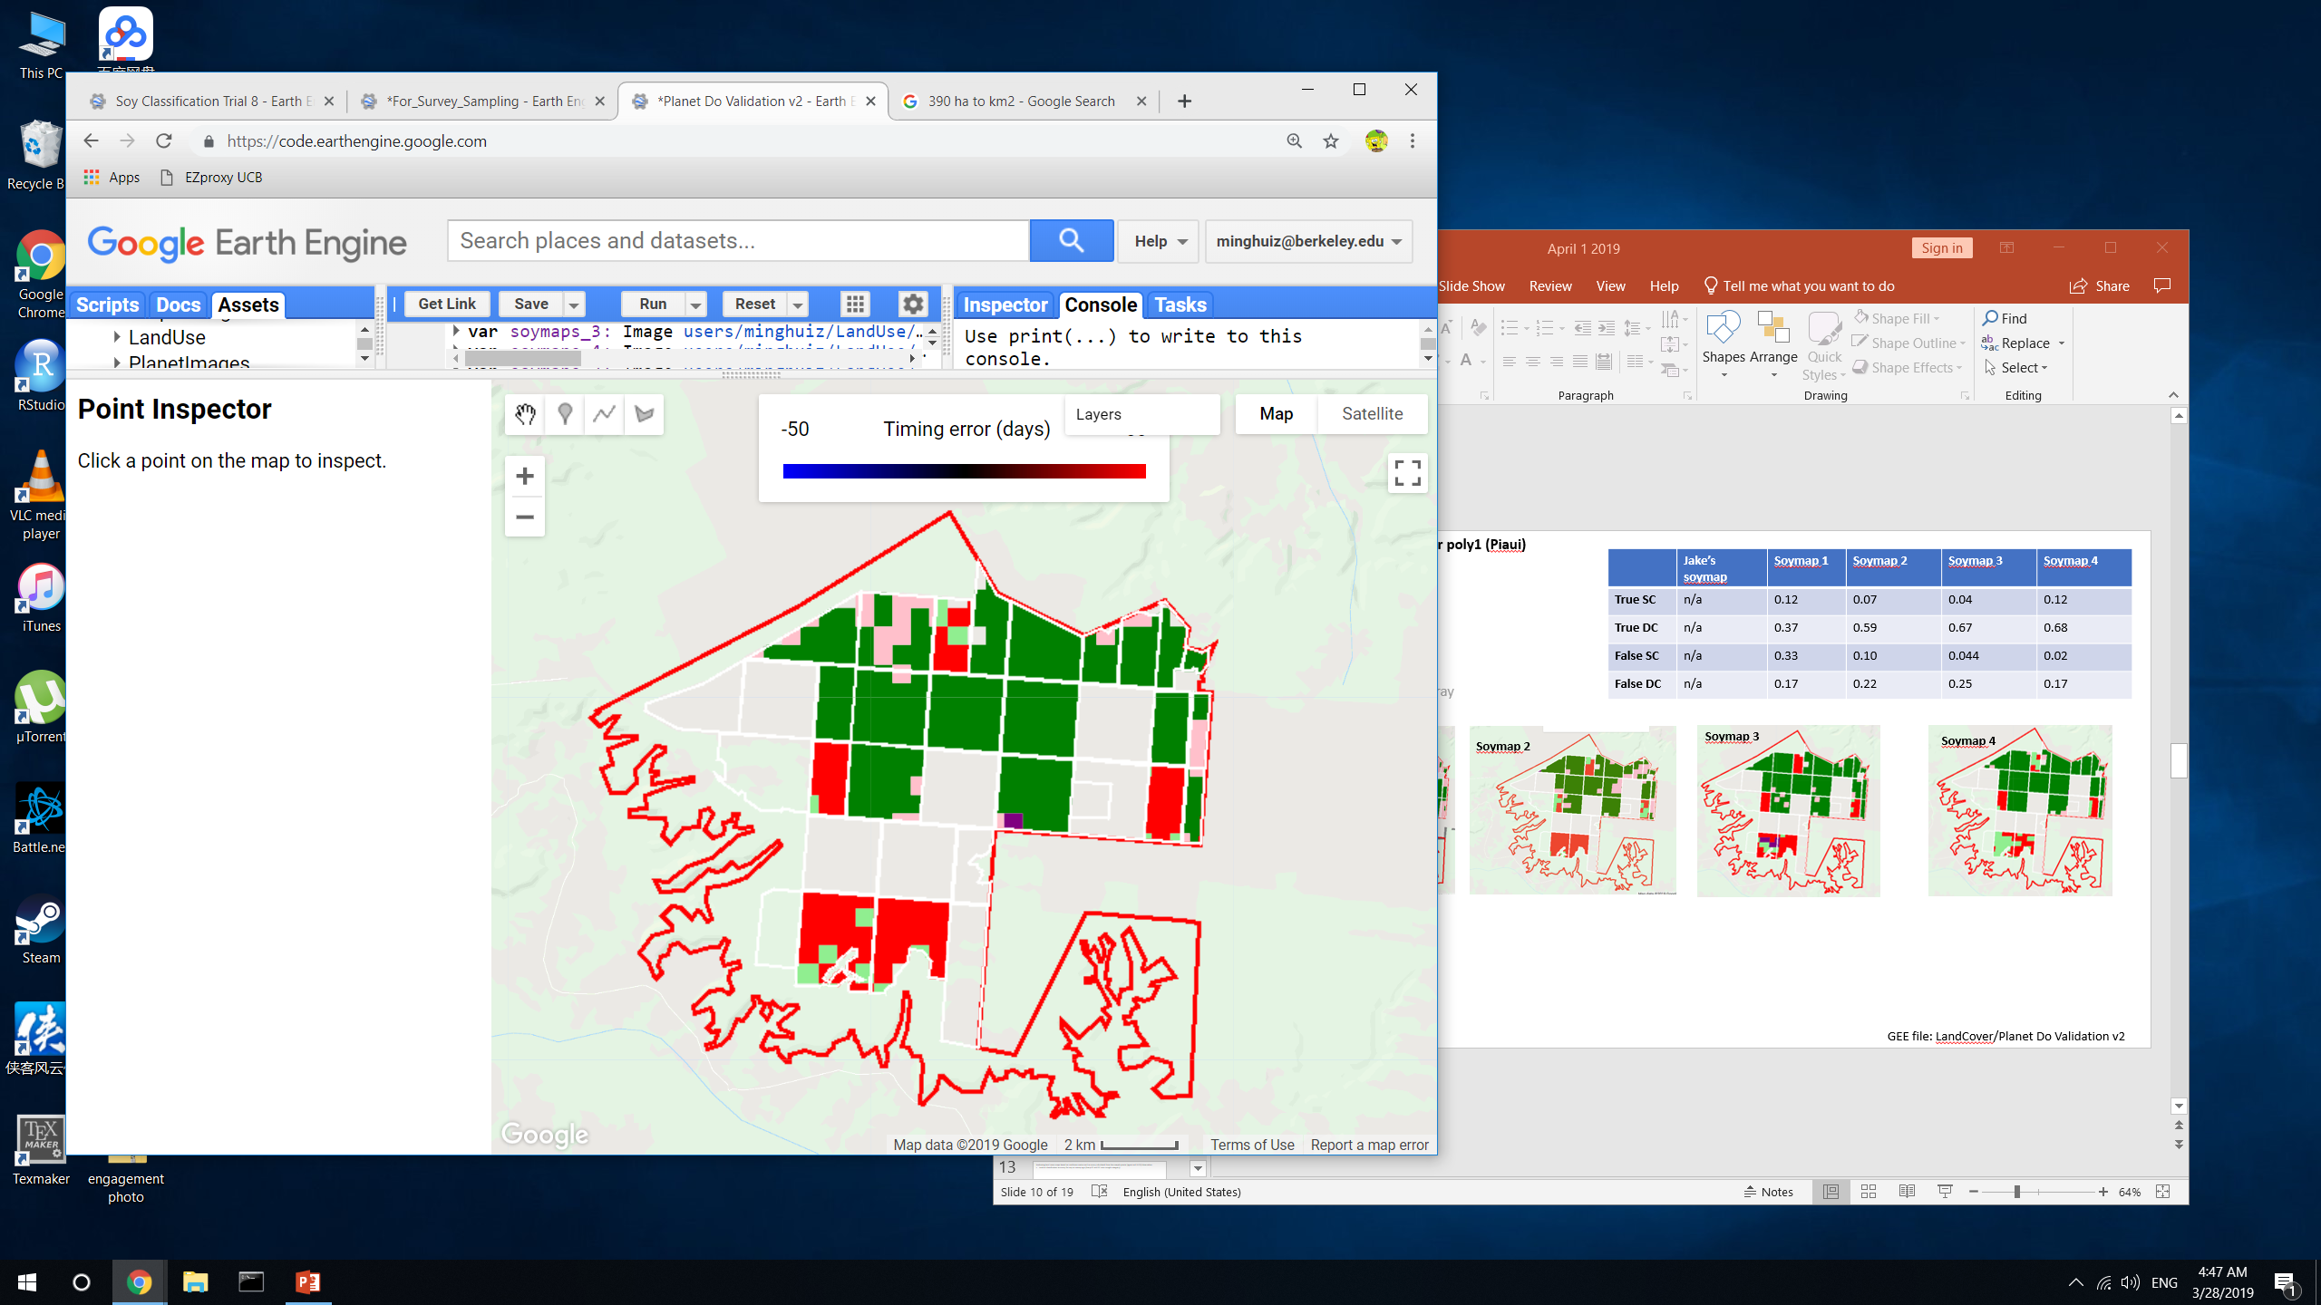
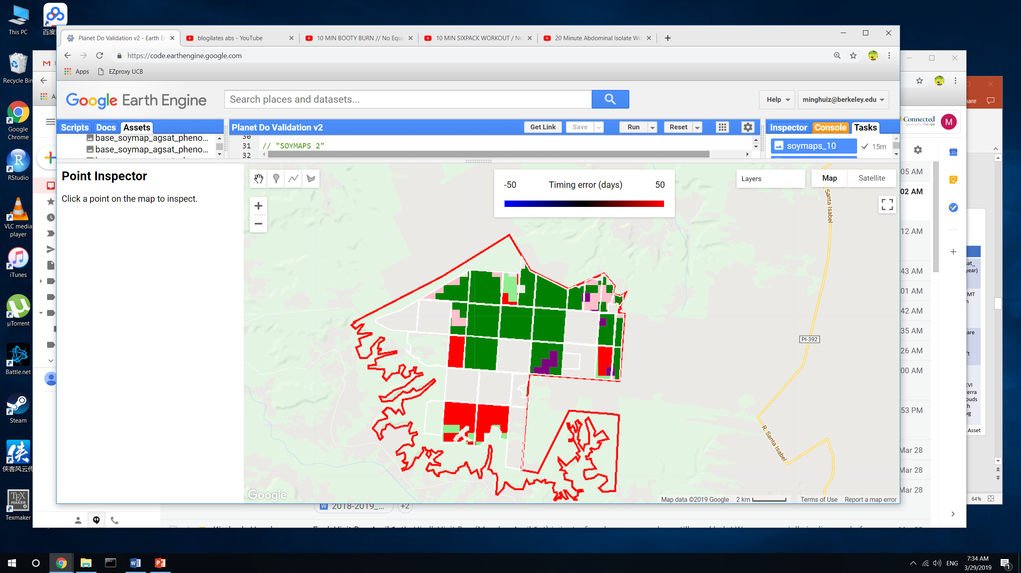
Land classification accuracy for poly1 (Piaui)
Legend:
True SC = light green
True DC = green
False SC = pink
False DC = red
False nonsoy agri = purple
False agri (actually natural) = gray
 | Jake’s soymap | Soymap 1 | Soymap 2 | Soymap 3 | Soymap 4 | Soymap 8 | Soymap 10
True SC | n/a | 0.12 | 0.07 | 0.04 | 0.12 | 0.05 | 0.06
True DC | n/a | 0.37 | 0.59 | 0.67 | 0.68 | 0.62 | 0.62
False SC | n/a | 0.33 | 0.10 | 0.044 | 0.02 | 0.07 | 0.08
False DC | n/a | 0.17 | 0.22 | 0.25 | 0.17 | 0.24 | 0.23
Soymap 1
Soymap 2
Soymap 3
Soymap 4
Soymap 8
Soymap 10
GEE file: LandCover/Planet Do Validation v2

Slide 9
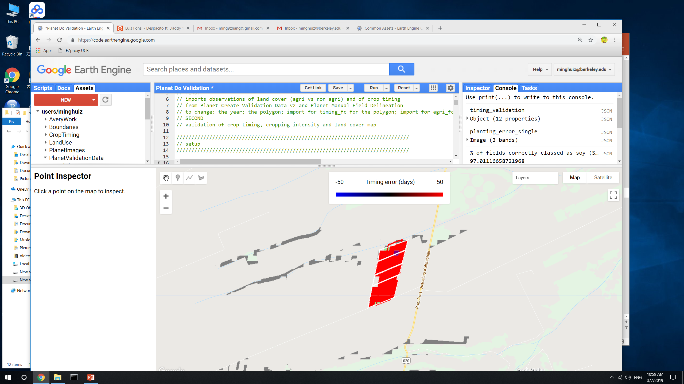
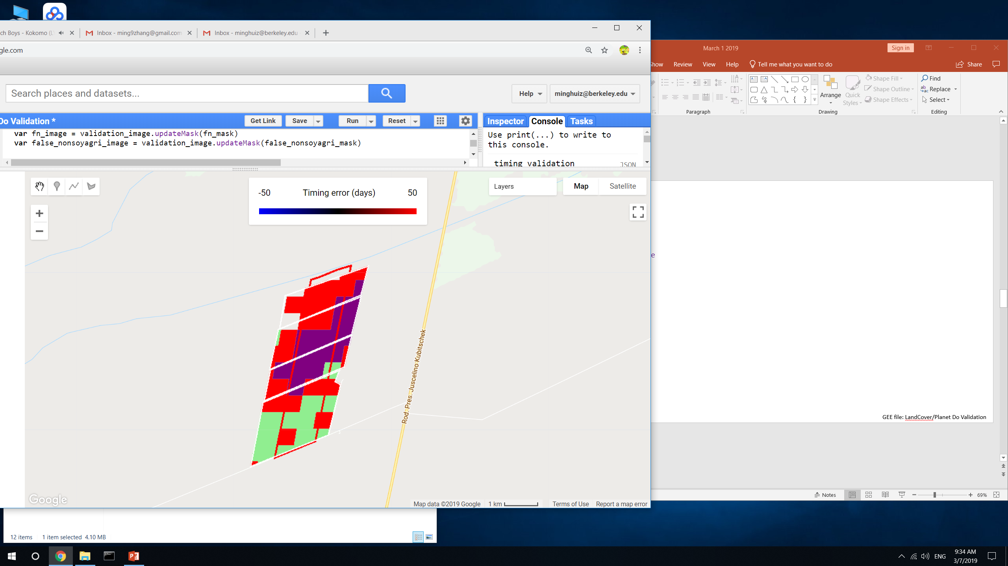
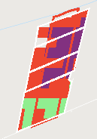
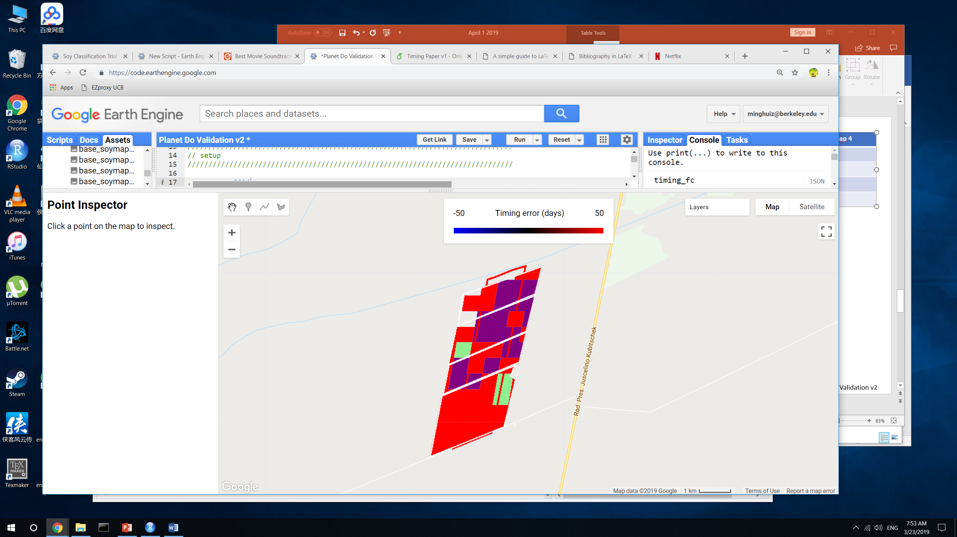
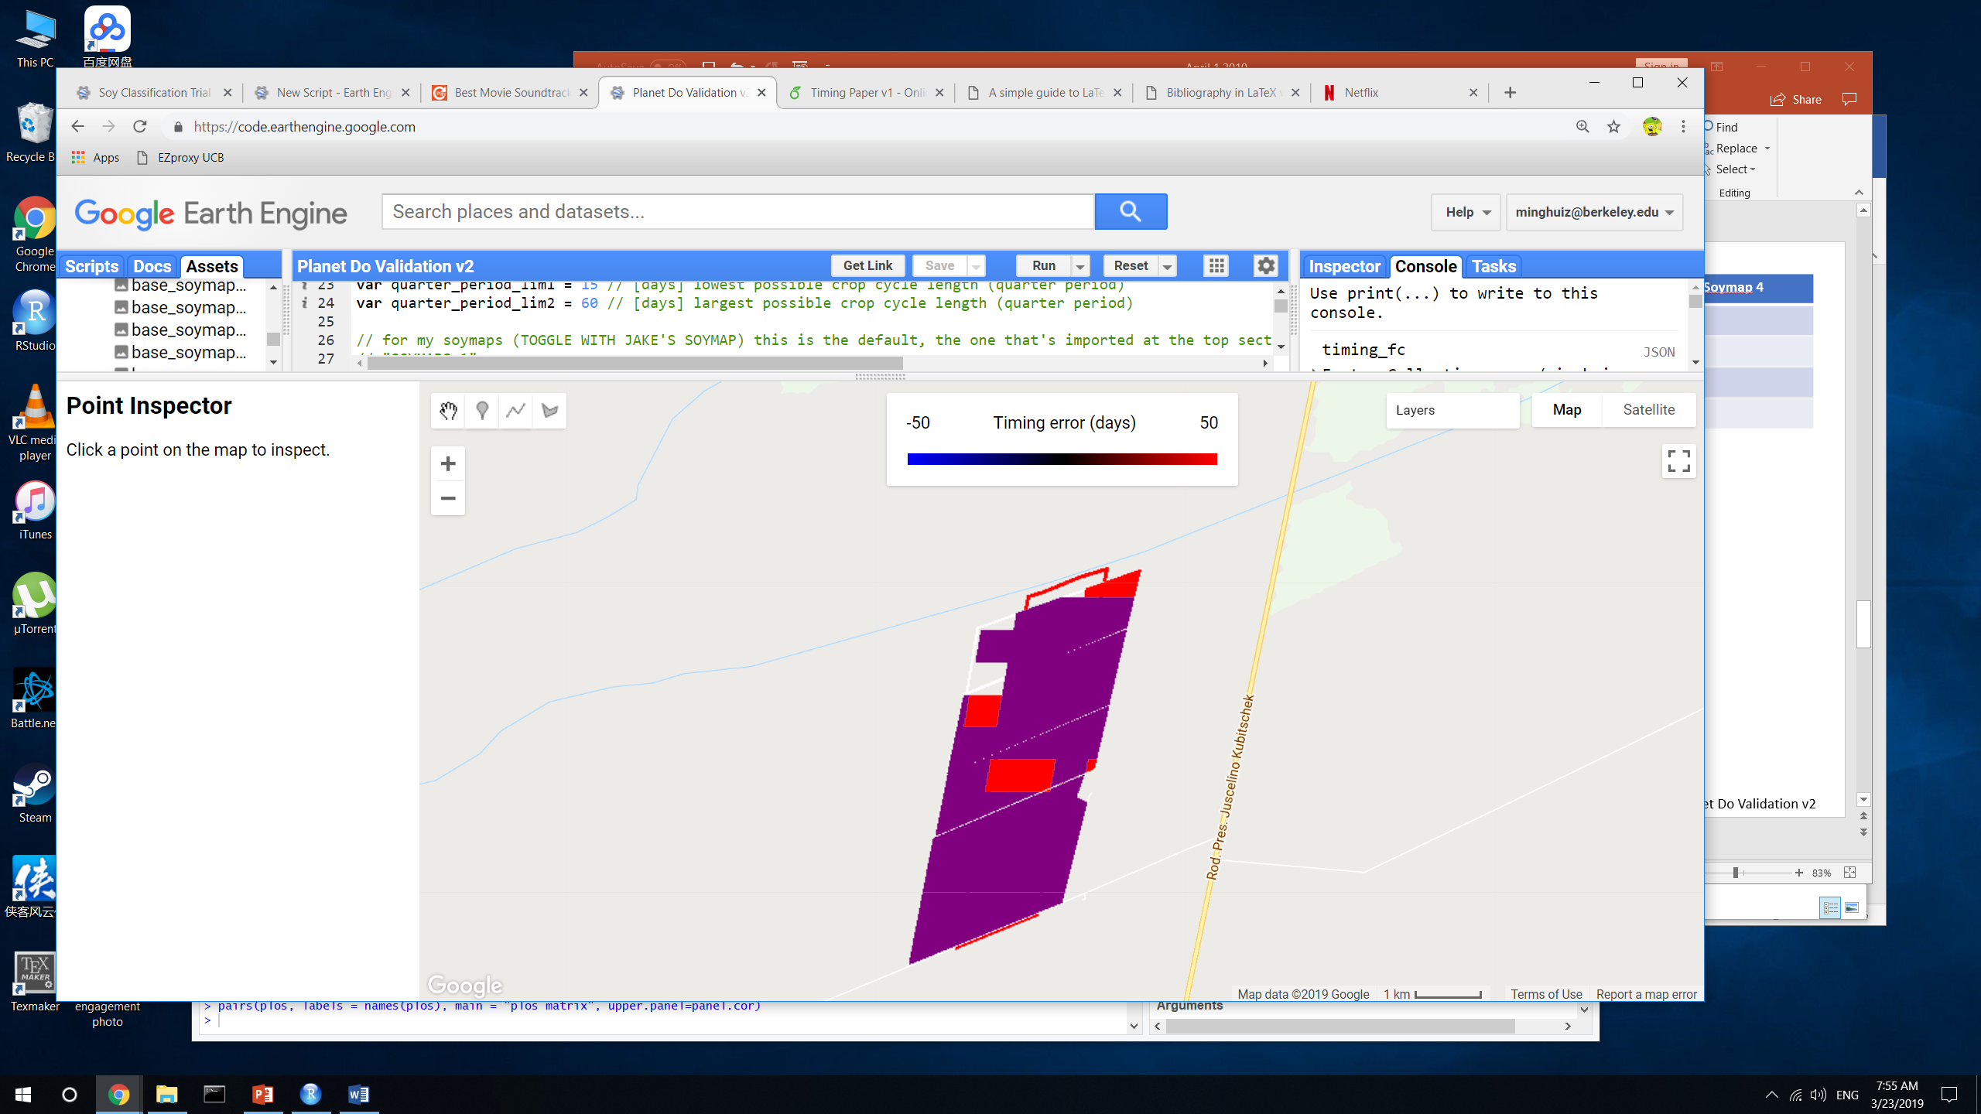
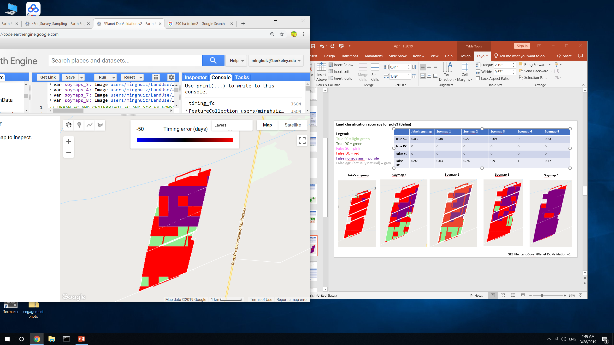
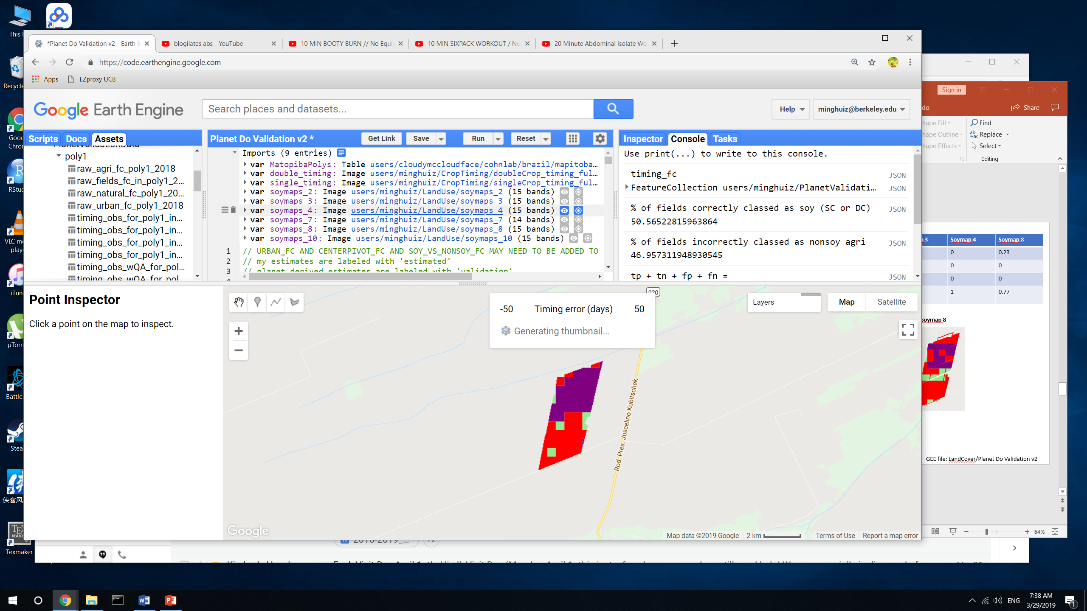
Land classification accuracy for poly3 (Bahia)
Legend:
True SC = light green
True DC = green
False SC = pink
False DC = red
False nonsoy agri = purple
False agri (actually natural) = gray
 | Jake’s soymap | Soymap 1 | Soymap 2 | Soymap 3 | Soymap 4 | Soymap 8
True SC | 0.03 | 0.38 | 0.27 | 0.09 | 0 | 0.23
True DC | 0 | 0 | 0 | 0 | 0 | 0
False SC | 0 | 0 | 0 | 0 | 0 | 0
False DC | 0.97 | 0.63 | 0.74 | 0.9 | 1 | 0.77
Jake’s soymap
Soymap 1
Soymap 2
Soymap 3
Soymap 4
Soymap 8
Soymap 10
GEE file: LandCover/Planet Do Validation v2

Slide 10
Land cover classification with more constrained input data

Slide 11
Based on spectral and phenological differences, target mid to late vegetative stage of first crop and the whole second crop; avoid dry season
Proposed input data for separating the three classes
From spectral differences (mid to late vegetative stage)
B2 (NIR) from Dec to June
B5 from Dec to June
B1 from Dec to Jan
B1 from July to Aug
From phenological differences (mid vegetative stage; usually the time fields transition from first to second crop)
EVI from January to March (NOT July to October)

Slide 12
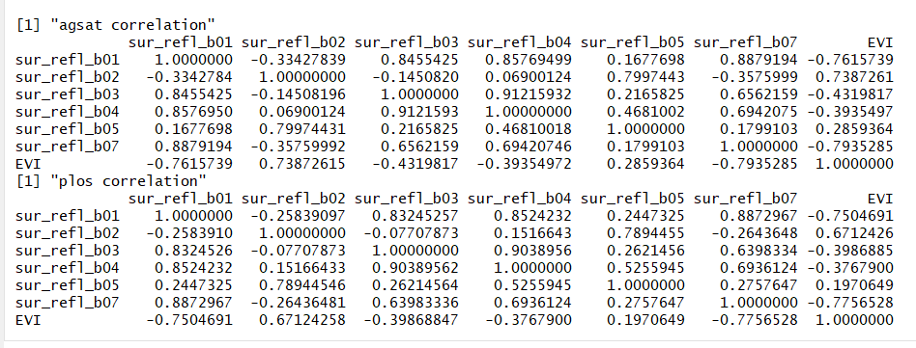
Check correlation between EVI and individual bands (if R < 0.07, put both EVI and individual bands in input)
R file: Band_correlations.Rmd

Slide 13
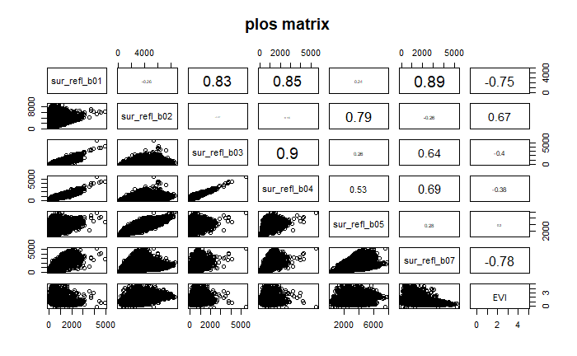
The numbers are correlation
Use two sets of input data:
B1 and b2 from December to June
EVI from December to June
R file: Band_correlations.Rmd

Slide 14
New soymaps (using additional training points beyond Jake’s method but fewer input data)
Pooling all years to train a single classifier
Adding PLOS training points
Two sets of input data:
1. band1 and band2 of MODIS from Dec to June
2. EVI from MODIS from Dec to June
 | Jake’s soymap | Soymap 1 | Soymap 2 | Soymap 3 | Soymap 4
GEE asset name | users/cloudymccloudface/cohnlab/agroserv/soy_sc_dc_agsat_mod_ls | Base_soymap_agsat_(year) for individual years soymaps for image collection of all years | Base_soymap_agsat_PLOS_(year) for individual years Soymaps_2 for image collection of all years | Base_soymap_agsat_PLOS_b1b2_(year) Soymaps_3 | Base_soymap_agsat_PLOS_EVI_(year) Soymaps_4
Training points | Soy_pts_agsat_1 (MT only) | Soy_pts_agsat_1 (MT only), masked with map3 agri | Soy_pts_agsat_1 (MT only), masked with map3 agri PLUS PLOS pts (MT only) | Soy_pts_agsat_1 (MT only), masked with map3 agri PLUS PLOS pts (MT only) | Soy_pts_agsat_1 (MT only), masked with map3 agri PLUS PLOS pts (MT only)
Year pooling | Each year has separate trained classifier | 2004-2017 points are pooled and are applied to 2004 – 2018; 2003 is trained and applied by itself | 2004-2017 points are pooled and are applied to 2004 – 2018; 2003 doesn’t have data yet | 2004-2017 points are pooled and are applied to 2004 – 2018; 2003 doesn’t have data yet | 2004-2017 points are pooled and are applied to 2004 – 2018; 2003 doesn’t have data yet
Input data | MODIS aqua, Landsat | Same as Jake’s soymap | Same as Jake’s soymap MINUS Landsat bands | MODIS aqua band 1 and 2 from Dec to June Landsat SRTM | MODIS aqua derived EVI from Dec to June Landsat SRTM
GEE file: LandCover/Soy Classification Trial 3, LandCover/Soy Classification Trial 4, LandCover/Soy Classification Create Final Asset

Slide 15
New soymaps
To start, these maps aren’t actually produced as assets – need to conserve asset storage space. Instead, export the accuracies wrt training points (agsat and PLOS) to see which are most accurate.
 | Soymap 5 | Soymap 6 | Soymap 7 | Soymap 8 | Soymap 9 | Soymap 10
GEE asset name | Base_soymap_agsat_reclassPLOS_EVI_(year) | Base_soymap_agsat_EVI_(year) | Base_soymap_agsat_phenology_(year) Soymaps_7 | Base_soymap_agsat_phenospectral_(year) Soymaps_8 | Base_soymap_agsat_phenospectral2_(year) | Base_soymap_agsat_phenospectral3_(year) Soymaps_10
Training points | Soy_pts_agsat_1 (MT only), masked with map3 agri PLUS reclassed PLOS pts (MT only) | Soy_pts_agsat_1 (MT only), masked with map3 agri | Soy_pts_agsat_1 (MT only), masked with map3 agri | Soy_pts_agsat_1 (MT only), masked with map3 agri | Soy_pts_agsat_1 (MT only), masked with map3 agri | Soy_pts_agsat_1 (MT only), masked with map3 agri
Year pooling | 2004-2017 points are pooled and are applied to 2004 – 2018; 2003 doesn’t have data yet | 2004-2017 points are pooled and are applied to 2004 – 2018; 2003 doesn’t have data yet | 2004-2017 points are pooled and are applied to 2004 – 2018; 2003 doesn’t have data yet | 2004-2017 points are pooled and are applied to 2004 – 2018; 2003 doesn’t have data yet | 2004-2017 points are pooled and are applied to 2004 – 2018; 2003 doesn’t have data yet | 2004-2017 points are pooled and are applied to 2004 – 2018; 2003 doesn’t have data yet
Input data | MODIS aqua derived EVI from Dec to June Landsat SRTM | MODIS aqua derived EVI from Dec to June Landsat SRTM | Phenology: fitted ampl; peak DOY; quarter pd; peak EVI | Phenology: fitted ampl; peak DOY; quarter pd; peak EVI MODIS aqua and terra | Phenology: fitted ampl; peak DOY; quarter pd; peak EVI MODIS aqua and terra band 1 and 2, masked for clouds and smoothed with moving window avg | Phenology: fitted ampl; peak DOY; quarter pd; peak EVI MODIS aqua and terra EVI, masked for clouds and smoothed with moving window avg
GEE file: LandCover/Soy Classification Trial 5 to 8, LandCover/Soy Classification Create Final Asset

Slide 16
Soymap 5 Notes
See slide before for details on how PLOS was reclassified (again). Got rid of pasture and turned soy-cotton in soy DC class.
Soymap 8 Notes
Didn’t mask out clouds (yet)
Unlike previous soymaps, added aqua and terra together to generate input data
Took phenological inputs of soymap 7 and added MODIS bands 1, 2 at the following phenological stages:
Min1 (peak1 – 2*quarterPeriod)
Infl1 (peak1 – quarterPeriod)
Min2 (peak2 + 2*quarterPeriod)
Infl2 (peak2 + quarterPeriod)
Took the median composite around each of these phen stages, +/- 8 days
Soymap 9 Notes
Mask out clouds
Instead of using raw MODIS spectral reflectance, smooth out the bands with moving average
take phenological inputs and spectral info, MODIS bands 1, 2, at the following phenological stages:
Min1 (peak1 – 2*quarterPeriod)
Infl1 (peak1 – quarterPeriod)
Min2 (peak2 + 2*quarterPeriod)
Infl2 (peak2 + quarterPeriod)
Took the median composite around each of these phen stages, +/- 5 days

Slide 17
Reclassified PLOS
Reclassify PLOS MT (again, different from soymaps 2 to 4) to get rid of pasture and classify soy-cotton as DC soy
Create a single training point for each year instead of lumping multiple years
Rules:
If old class of PLOS == 2, new class of PLOS == 0
If old class of PLOS == 1 or == 9, new class of PLOS == 1
If old class of PLOS == 0 or == 4, new class of PLOS == -1 (missing value)
If old class of PLOS == 3, new class of PLOS == 2
After restructuring PLOS, filter out class = -1 (missing value)
 | PLOS MT | Soy_pts_agsat_1
Description | Only in Mato Grosso (is the ‘new one’) | Only in Mato Grosso
GEE asset id | users/minghuiz/LandUse/MT_ground_reference_data_PLOS_2017 | users/cloudymccloudface/cohnlab/agroserv/soylc_train_pts_agsat_1
Years | 2005 – 2013 | 2003 - 2017
Property name | clsidYEAR (YEAR = 2005 to 2013) | class
soy-single | 2 | 0
Soy-double | 1 | 1
Agri, nonsoy | n/a | 2
Cotton | 3 | n/a (would be 2 in restructured PLOS)
Pasture/cerrado | 4 | n/a (would be -1 in restructured PLOS)
Soy-cotton | 9 | n/a (would be 1 in restructured PLOS)
Unknown value | 0 | n/a (would be -1, i.e. missing value, in restructured PLOS)
GEE file LandCover/Soy Classification Trial 2

Slide 18
Land classification accuracy for poly5 (MT)
True SC = light green
True DC = green
False SC = pink
False DC = red
False nonsoy agri = purple
False agri (actually natural) = gray
 | Jake’s soymap | Soymap 1 | Soymap 2 | Soymap 3 | Soymap 4 | Soymap 7 | Soymap 8 | Soymap 10
True SC | 0.01 | 0.005 | 0.015 | 0 | 0.002 | 0.01 | 0.01 | 0.01
True DC | 0.78 | 0.86 | 0.9 | 0.89 | 0.93 | 0.87 | 0.87 | 0.84
False SC | 0.18 | 0.11 | 0.07 | 0.07 | 0.04 | 0.1 | 0.1 | 0.12
False DC | 0.02 | 0.03 | 0.02 | 0.03 | 0.03 | 0.02 | 0.02 | 0.02
Jake’s soymap
Soymap 1
Soymap 2
Soymap 3
Soymap 4
Soymap 7
Soymap 8
Soymap 10
GEE file: LandCover/Planet Do Validation v2

Slide 19
Land classification accuracy for poly1 (Piaui)
Legend:
True SC = light green
True DC = green
False SC = pink
False DC = red
False nonsoy agri = purple
False agri (actually natural) = gray
 | Jake’s soymap | Soymap 1 | Soymap 2 | Soymap 3 | Soymap 4 | Soymap 8 | Soymap 10
True SC | n/a | 0.12 | 0.07 | 0.04 | 0.12 | 0.05 | 0.06
True DC | n/a | 0.37 | 0.59 | 0.67 | 0.68 | 0.62 | 0.62
False SC | n/a | 0.33 | 0.10 | 0.044 | 0.02 | 0.07 | 0.08
False DC | n/a | 0.17 | 0.22 | 0.25 | 0.17 | 0.24 | 0.23
Soymap 1
Soymap 2
Soymap 3
Soymap 4
Soymap 8
Soymap 10
GEE file: LandCover/Planet Do Validation v2

Slide 20
Land classification accuracy for poly3 (Bahia)
Legend:
True SC = light green
True DC = green
False SC = pink
False DC = red
False nonsoy agri = purple
False agri (actually natural) = gray
 | Jake’s soymap | Soymap 1 | Soymap 2 | Soymap 3 | Soymap 4 | Soymap 8
True SC | 0.03 | 0.38 | 0.27 | 0.09 | 0 | 0.23
True DC | 0 | 0 | 0 | 0 | 0 | 0
False SC | 0 | 0 | 0 | 0 | 0 | 0
False DC | 0.97 | 0.63 | 0.74 | 0.9 | 1 | 0.77
Jake’s soymap
Soymap 1
Soymap 2
Soymap 3
Soymap 4
Soymap 8
Soymap 10
GEE file: LandCover/Planet Do Validation v2

Slide 21
Evaluating land cover maps based on confusion matrix and accuracy calculated from the sample points (agsat and PLOS) themselves
Accuracies are available for Mato Grosso only
These are NOT calculated from Planet imagery, because Planet imagery might give overly optimistic view (maps do well for DC, and chances are high that DC is the only class seen in Planet imagery)
Note that some are only tested wrt agsat while others are tested wrt agsat + PLOS; so the accuracies might not be comparable
PLOS points (in Soymap 2, 3, and 4) contain pasture, which would be masked out with mapbiomas anyway. This might confuse the classifier and bring nonsoy agri accuracy down.
TAKEAWAY: SC soy and nonsoy agri are consistently poorly classified, and slight variations in training points and input data only provide incremental improvements
 | Class | Jake’s map | Soymap 1 | Soymap 2 | Soymap 3 | Soymap 4 | Soymap 5 | Soymap 6 | Soymap 7 | Soymap 8 | Soymap 9 | Soymap 10
Accuracy |  | 76 | 76.9 | 73.5 | 75.2 | 76.7 | 78.5 | 79.7 | 81.8 | 81.1 | 78.8 | 82.5
Consumer’s accuracy | 0 | 0.39 | 0.51 | 0.45 | 0.44 | 0.52 | 0.54 | 0.51 | 0.58 | 0.58 | 0.47 | 0.59
 | 1 | 0.85 | 0.85 | 0.8 | 0.8 | 0.8 | 0.82 | 0.84 | 0.86 | 0.85 | 0.84 | 0.86
 | 2 | 0.47 | 0.4 | 0.35 | 0.44 | 0.53 | 0.46 | 0.47 | 0.57 | 0.58 | 0.49 | 0.65
Producer’s accuracy | 0 | 0.39 | 0.47 | 0.35 | 0.25 | 0.24 | 0.29 | 0.33 | 0.44 | 0.35 | 0.33 | 0.44
 | 1 | 0.85 | 0.86 | 0.86 | 0.9 | 0.92 | 0.92 | 0.92 | 0.92 | 0.93 | 0.91 | 0.92
 | 2 | 0.44 | 0.47 | 0.3 | 0.37 | 0.4 | 0.35 | 0.31 | 0.4 | 0.47 | 0.36 | 0.44
GEE file: LandCover/Soy Classification Variations, …Trial 1, …Trial 2 v2, …Trial 3, …Trial 4

Slide 22
Evaluating land cover maps based on confusion matrix and accuracy calculated from the sample points (agsat and PLOS) themselves
Look at classification accuracy for soy vs nonsoy agri (lump SC and DC into a single category)
Since DC is so much more accurate, report information only for DC crops?

Slide 23
(Zhong et al, 2016) : mapped soy and corn with phenology in Parana
MODIS data inputs to derive vegetation phenology parameters using (Soudani et al, 2008)’s asymmetric double sigmoid function
Vegetation phenology parameters were used as input data to decision tree classifier
Classification results were biased on topography – scattered crop fields in mountainous regions with dense natural vegetation tend to be overlooked
TAKEAWAY: improvement using different inputs based on MODIS bands is only incremental, can’t get up to ~80% accuracy. Revisit the use of phenology metrics in classification?

Slide 24
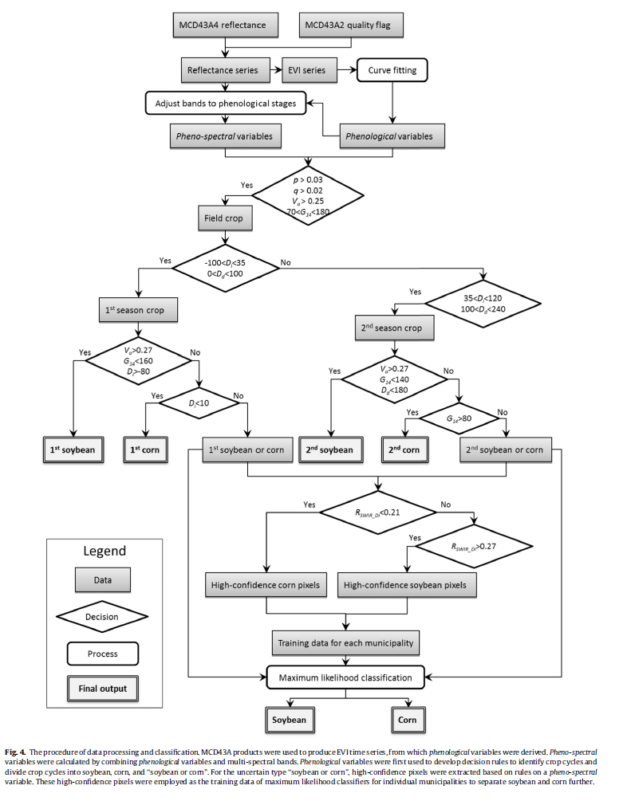
(Zhong et al, 2016) : mapped soy and corn with phenology in Parana
Process
They trained on the phenological parameters themselves, but also on surface reflectance at specific phenological stages. This is because using phenological stages alone is subject to inter-annual and inter-regional variation in the crop calendar, so the dynamics of spectral properties might be more reliable. SWIR can separate corn from soy; it represents canopy water content.
Input data (pheno-spectral):
Shortwave infrared (Band 6 of MODIS) at D1 to D4, 1628 – 1652nm
Amplitude between baseline EVI and peak EVI
Di, Dd, D1 to D4 (the actual dates)
G14 (difference between D4 and D1, i.e. length of growing season)
P, q: rate of change parameters of the increasing and decreasing segments in the EVI
Manually made the decision tree classifier
My version’s input data:
Previously calculated phenological params
Amplitude of fitted EVI timeseries
Peak DOY
Quarter period
Value of EVI at peak
Peak2 – peak1
MODIS spectral reflectance at min1, infl1, peak, infl2, min2 (different stages of the crop cycle)

Slide 25
Next

Slide 26
Crop timing
For natural vs agri accuracy, try masking edges and masking by crop cycle and peak EVI target only agri
Look at the dates corresponding to the low error fields and see if they represent the full range of crop dates represented by all the fields, because there might be a bias towards fields that were planted at a time when there weren’t clouds. This bias would also be solved if there are many locations of validation data.
Check QA/QC for the small peak before the larger peak (base threshold off places we know are DC and what the peak height is), and also chase down the algorithm error in the red pixel in Mato Grosso timing validation
Attach error distributions to crop timing estimates
At pixel and field/aggregated scale
Based on width of validation range and ‘range error’
Do all pixels/cells have the same error?
Separate errors for p1, (h1 + p2), and h2 (due to likelihood of clouds impacting TS analysis)
NEXT Planet image downloads:
For poly6 to 8 (based on soy_pts_agsat1), only download for 2016-2017. these are in MT – try to go for about 30 to 40 fields in different locations instead of 80 fields in a single location because of potential bias due to cloudy days
In MT, look at a place with SC (based on agsat training) and download for a place with known SC – useful for seeing accuracy of classifying SC
Monitor BearBuy for Planet purchase
Colab: best way to use Python API with GEE (ipython notebook server)
Do pip install earthengine-api in colab to get virtual machine
Import ee
ee.Initialize()
ee.batch.Task.list() – proves can use earth engine
Docs: github/earthengine-api -> python -> examples -> ipynb -> example stuff

Slide 27
Planet imagery workflow
Uploading planet images as GEE asset
Properties of each image in PlanetLabs folder
Year, Month, Day, Satellite
PS_analytic_4band
RE_ortho_analytic
PS_ortho_analytic
PS_scene_analytic
Asset name is same as the description used in downloading from Planet web site
Lookup table in desktop has Planet order number and description and GEE asset name
Step | To do | Script/web site
1 | Find locations, years where Planet images are needed. Keep info on shp name, image name(s), and dates downloaded in Image_Lookup file in Google Drive | GEE: LandCover/Planet Image Selection
2 | Download cloud free, high temporal resolution Planet images (may need to pare down on locations, years) | Planet web site. Keep downloaded images in desktop
3 | Upload images as GEE assets | In desktop, keep tabs on asset id, polygon name, etc.
4 | Delineate individual fields, natural veg, agri, urban (houses) and center pivot in Planet imagery, and export as asset into the folder Planet Validation Data. The difference between fields and agri is that the fields contain individual (usu square) fields for timing observation purposes, whereas the agri contains lumped agri for land classification (natural vs agri) purposes. Assets are exported as ‘raw_agri_fc_poly1_year’, etc. need to turn delineated geometries into feature collections in order to export. | GEE: LandCover/Planet manual Field Delineation or Planet OBIA
5 | First import the Planet images and make custom visualizations for each, and map each with its own custom vis. Step through fields in CAR poly and record observed crop timing, export observations as feature collection to asset. Assets are exported as ‘timing_obs_for_polyName_in_year_part#’. Make sure to change the ‘part#’ BEFORE entering obs! 0 for SC, 1 for DC, 3 for TC or DC + failed first crop (2 is other agri in Jake’s classification) | GEE: Planet Create Validation Data v2
5.5 | (for poly1, poly3, and poly5), go back to the timing validation data exported from Planet Create Validation Data v2 and add ‘confidence level’ for my crop timing and crop intensity validation dataset; use MODIS TS to help replace previous crop intensity classification. For confidence labels, use -1 for no data (i.e. no second crop); 0 for no confidence; 1 for confident | GEE: Planet Add QA for Validation Data
6 | Import timing and land cover feature collections. May need to combine timing feature collections into a single fc. Turn feature collection of observations into validation image (might need to first merge multiple obs fcs into a single one), use to do validation. The following are turned into dictionaries of images (or simply images): the observed plant/harvest times; the observed cropping intensity; the observed land cover (agri - 10, center pivot - 20, natural - 30, urban – 40). Use images to do validation of timing and land cover maps. | GEE: Planet Do Validation

